Slide 1

Mathematics 3C/3D
Number and Algebra
Space and Measurement
Chance and Data

Slide 2

Number and Algebra
Estimation and calculation
Functions and graphs
Equations and inequalities
Calculus
Patterns

Slide 3
Space and Measurement
Rate
Measurement
Reason Geometrically

Slide 4
Chance and Data
Quantify chance
Interpret chance
Represent data
Interpret data

Slide 5
Number and Algebra
Important terms:
Natural numbers
Whole numbers
Prime numbers
Integers
Composite numbers
Rational numbers
Irrational numbers
Real numbers

Slide 6
Number and Algebra
Natural numbers:
Number used to count, {1, 2, 3, …}
Whole numbers
The non-negative numbers, {0, 1, 2, 3,…}
Integers
Consists of positive and negative integers
0 is neither positive nor negative

Slide 7
Number and Algebra
Prime numbers:
Natural numbers that can only be divided
by 1 and itself, {2, 3, 5, 7 …}
Composite numbers
Positive integer which has positive divisor
other than 1 or itself, {4, 6, 8, 9…}
1 is neither prime nor composite numbers

Slide 8
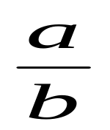
Number and Algebra
Rational numbers:
Any numbers than can be expressed as
the quotient of
Include integers, terminating decimal
numbers and repeating decimal numbers
Irrational numbers
Not a rational numbers

Slide 9
Number and Algebra
Estimation and calculation
Take note on:
significant figures
decimal places
number of item: answer in whole number
Exact values
approximation

Slide 10
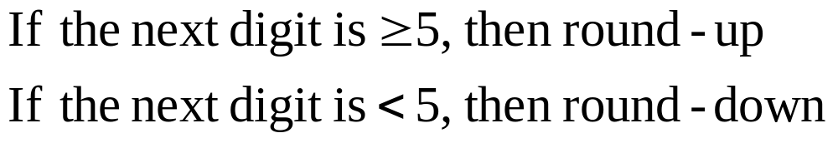
Number and Algebra
Useful steps:
Write down initial calculator display in full before rounding off
Decimal figures begin with the first digit after the decimal point
Significant figures begin with the first non-zero digit
Scientific notation is expressed as a number between 1 and 10 multiplied by a power of ten
Rounding off:

Slide 11
Number and Algebra
Interval:
(a, b) = a < x < b
[a,b] = a ≤ x ≤ b

